Slide 1

Black History Month

Slide 2
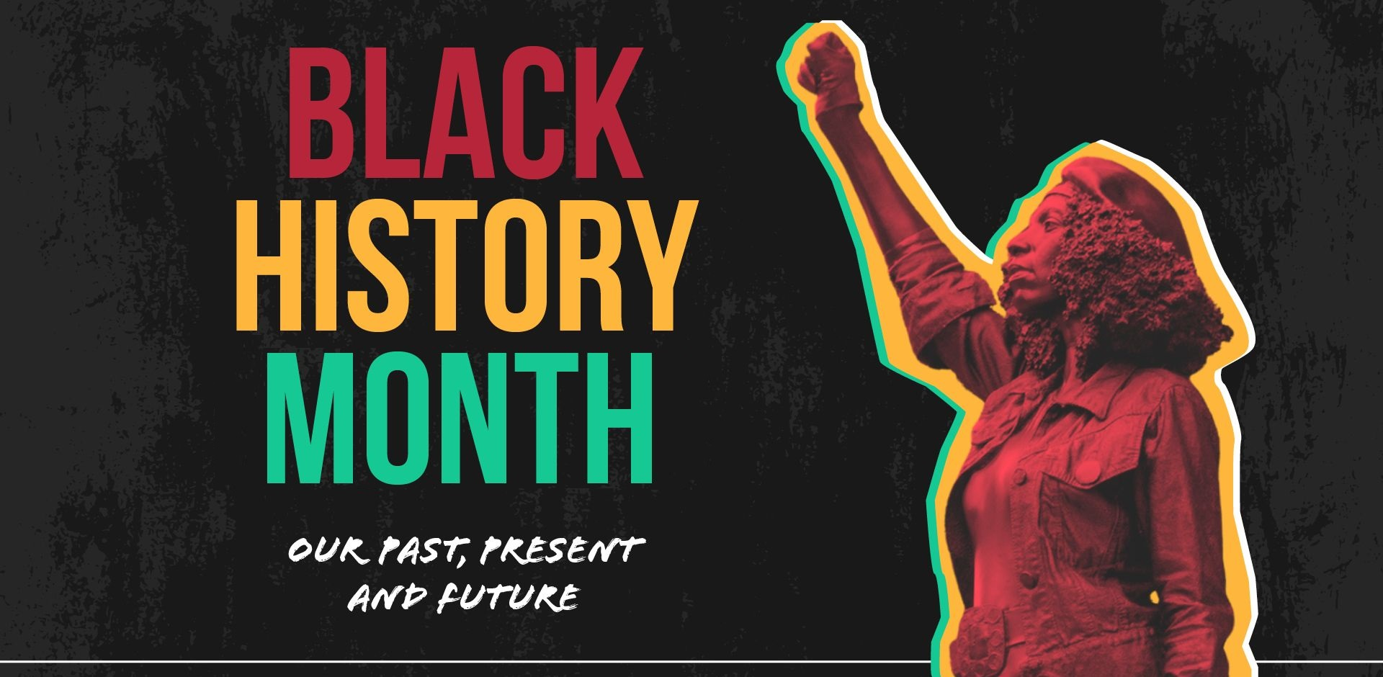
What is the Black History Month
Black History Month is an annual observance originating in the United States, where it is also known as African-American History Month. It has received official recognition from governments in the United States and Canada, and more recently has been observed in Ireland, and the United Kingdom. It began as a way of remembering important people and events in the history of the African diaspora. It is celebrated in February in the United States and Canada, while in Ireland, and the United Kingdom it is observed in October.
The precursor to Black History Month was created in 1926 in the United States, when historian Carter G. Woodson and the Association for the Study of Negro Life and History (ASNLH) announced the second week of February to be "Negro History Week".

Slide 3
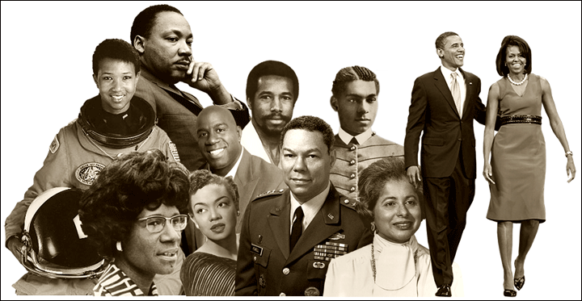
What is Black History Month About?
Black history is British history. They celebrate the contributions of Black people all year round however, October is a month where we focus on the experience and success of people of African and Caribbean ancestry.
Black History Month was created to focus attention on the contributions of African Americans to the United States. It honors all Black people from all periods of U.S. history, from the enslaved people first brought over from Africa in the early 17th century to African Americans living in the United States today.

Slide 4
The Activity in the Black History Month
1. Bring art and history together by recreating civil rights freedom movement posters.
2. Explore Black history through primary sources from the National Archives.
3. Let artists inspire your Black History Month activities.
4. Watch a Black History Month video.
5. Learn about the Black Lives Matter movement.

